Slide 1

Q-learning on the FrozenLake Environment
Course: Reinforcement Learning
GITHUB: https://github.com/ALLEN71999/RL-FrozenLake-Project
Student Name: XUZHENGDONG
Student ID: 20211902
Date: Dec. 2025

Slide 2

Background and Motivation
Reinforcement Learning
FrozenLake Task
Project Goal
An agent learns by interacting with an environment, receiving feedback to improve its actions over time.
A classic grid-world problem where an agent navigates to a goal while avoiding failure states (holes).
Implement Q-learning from scratch and evaluate its performance in the FrozenLake environment.

Slide 3

The FrozenLake Environment
FrozenLake is a discrete grid environment, where each cell represents a unique state. The agent's objective is to navigate from a starting point to a designated goal state.
The agent has four possible actions: Left, Down, Right, and Up. The challenge lies in safely reaching the terminal goal state while avoiding "frozen" areas that lead to failure.

Slide 4




Reinforcement Learning Problem Formulation
State
The agent's current position index within the grid environment.
Action
The four possible movements: Left, Down, Right, Up.
Reward
A positive reward (+1) for reaching the goal, and 0 otherwise.
Objective
To maximize the cumulative reward obtained over time by finding an optimal path.

Slide 5
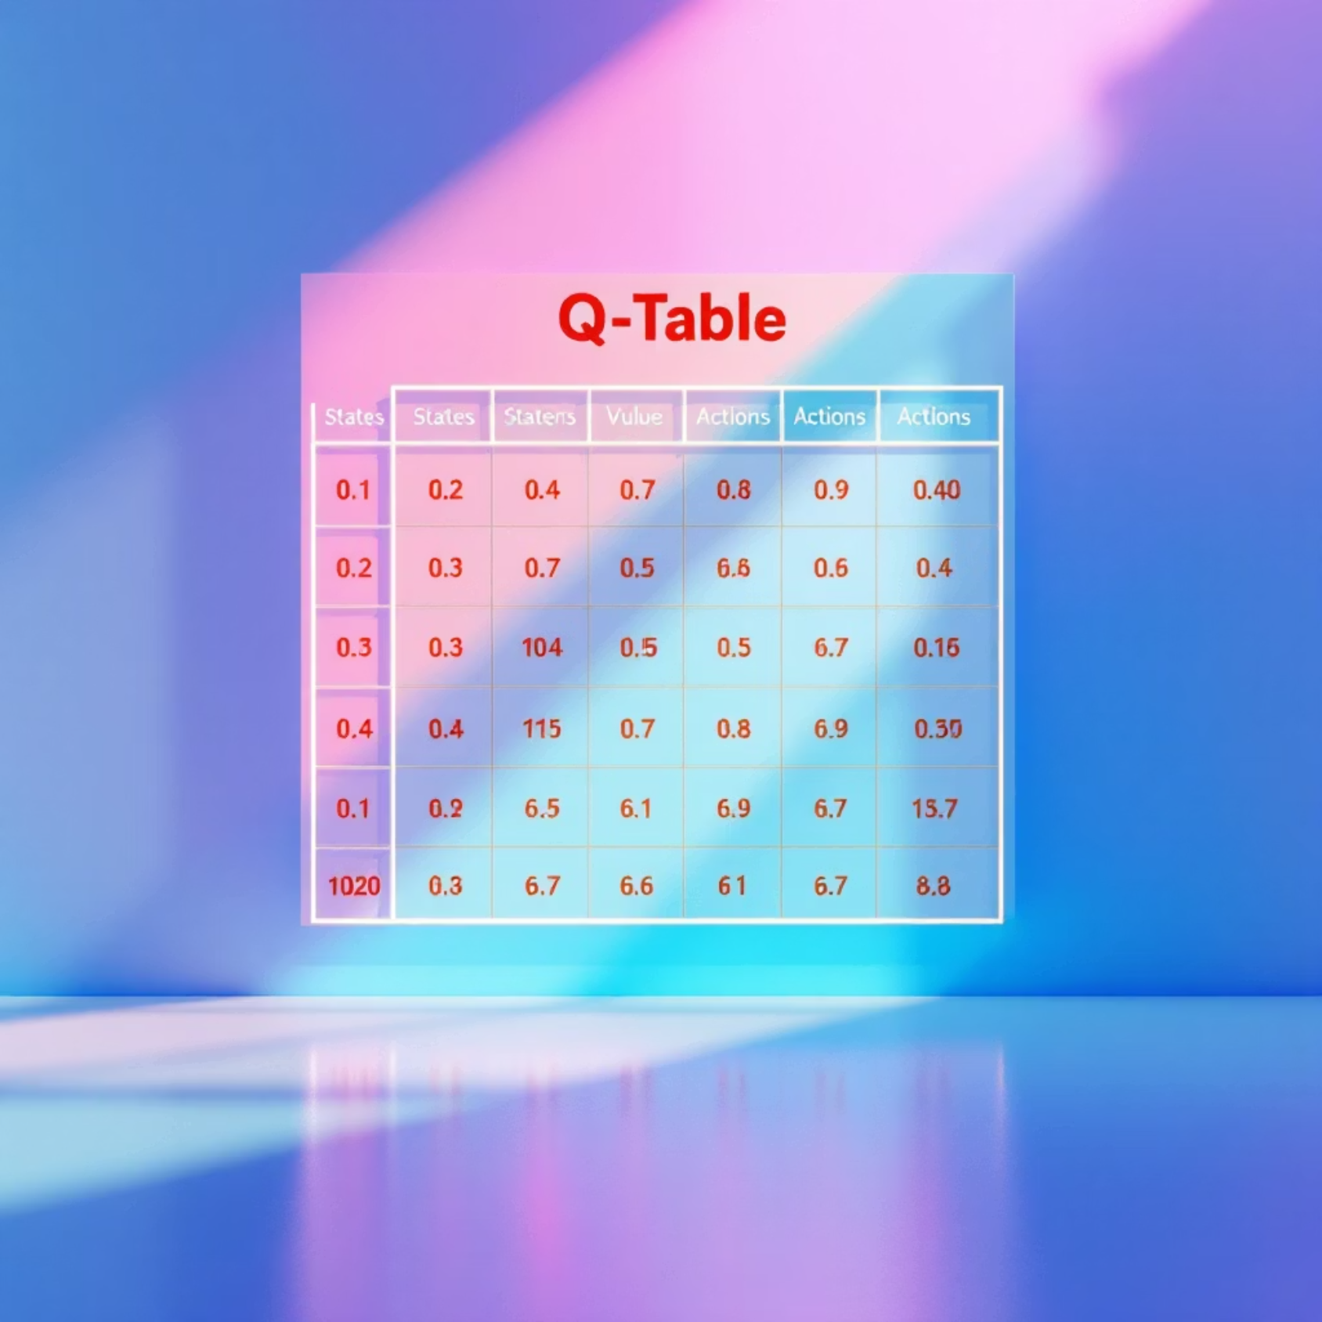
Algorithm Used: Tabular Q-learning
This project utilizes tabular Q-learning, a model-free reinforcement learning algorithm. It's designed to find an optimal action-selection policy for any given finite Markov Decision Process (MDP).
A Q-table is central to this algorithm. It stores the expected future return for each possible state-action pair, guiding the agent's decisions.
The agent continuously updates these Q-values through repeated interactions with the environment, gradually learning which actions are most beneficial in each state.

Slide 6
Q-learning Update Rule
The core of Q-learning lies in its update rule, which allows the agent to learn the value of taking an action in a particular state, considering future rewards:
This formula enables the agent to incorporate immediate rewards and the maximum expected future reward from the next state (s'), adjusted by the learning rate (alpha) and discount factor (gamma). This process helps the agent learn long-term optimal strategies.

Slide 7

Exploration Strategy: Epsilon-Greedy
1
2
Explore Randomly
Exploit Knowledge
With a probability of epsilon, the agent chooses a random action to discover new paths and potential rewards.
With a probability of 1 - epsilon, the agent selects the action with the highest Q-value, leveraging its learned experience.
3
Dynamic Epsilon
The value of epsilon gradually decreases during training, shifting the agent from exploration to exploitation as it learns more.

Slide 8




Main Experiment Setup
Environment
A standard 4x4 FrozenLake map, providing a compact yet challenging learning space.
Transitions
Deterministic (non-slippery) transitions, meaning actions always lead to the intended next state.
Training Episodes
The agent undergoes 3000 training episodes to learn and refine its Q-values.
Evaluation Episodes
Performance is assessed over 200 evaluation episodes to measure the learned policy's effectiveness.

Slide 9

Main Experiment Results
The Q-learning agent successfully learned an optimal policy for the 4x4 FrozenLake environment. This demonstrates the algorithm's effectiveness in smaller, deterministic settings.
The evaluation success rate consistently reached 1.0, indicating that the agent reliably found the goal in every test episode. This outcome confirms the correctness and robustness of the Q-learning implementation.

Slide 10

Extended Experiment: 6x6 FrozenLake
To further challenge the Q-learning algorithm, an extended experiment was conducted on a larger 6x6 FrozenLake map.
This increased grid size significantly expands the state space, presenting a more complex environment for the agent to navigate. Despite the larger map, rewards remain sparse, meaning positive feedback is infrequent and only occurs upon reaching the goal.

Slide 11

THANK YOU.
20211902
XUZHENGDONG

